Slide 1
Optimizing Obstetrical Care Using Interactive Medical Intelligence
Birth Congress 2022
Clinical Challenges in Labor and Delivery
Gerard Pregenzer, MD, FACOG, FACS, FICS
Department OB/GYN St Peter’s Medical Center: New Brunswick, NJ
-IMI: Warren, NJ
Milan, Italy 8 December 2022

Slide 2
Interactive Medical Intelligence
Active OB > 30 years
Chair Department OB/GYN
Quality Assurance
Representative for NJ State Board of Medical Examiners
Tasked to analyze "problem cases" with poor obstetrical outcomes, to identify root causes, and offer solutions to protect baby and mother.
It is clear there is a need for a system to interact contemporaneously with the patient's pregnancy progress, incorporating and analyzing data as entered, not just to report.

Slide 3
Dear Colleagues:
Our neonatologists are concerned that fetal abnormalities found on prenatal ultrasounds are not being transmitted to them.
In many cases they are not even mentioned in the patient's chart.
Two recent “near misses” have highlighted the problem- one involving a suspected cardiac anomaly, the other hydronephrosis. In NEITHER case did the relevant information appear in the patient's chart, nor were the neonatologists informed by the delivering OB or L&D staff. In both cases one of the parents informed them of the abnormal prenatal findings (albeit quite inaccurately), shortly before discharge from the Nursery. Baby #1 required emergency surgery for critical coarctation of the aorta; baby #2 underwent emergency surgery for an obstructing ureterocele. These are the ones they know about.
Please be sure that abnormal finding that may affect the immediate post-partum care of the infant are adequately documented in the chart or, at least, communicated verbally to the neonatal group.
Thank you,
Chairman, Department of Obstetrics & Gynecology

Slide 4
Cover Screen

Slide 5
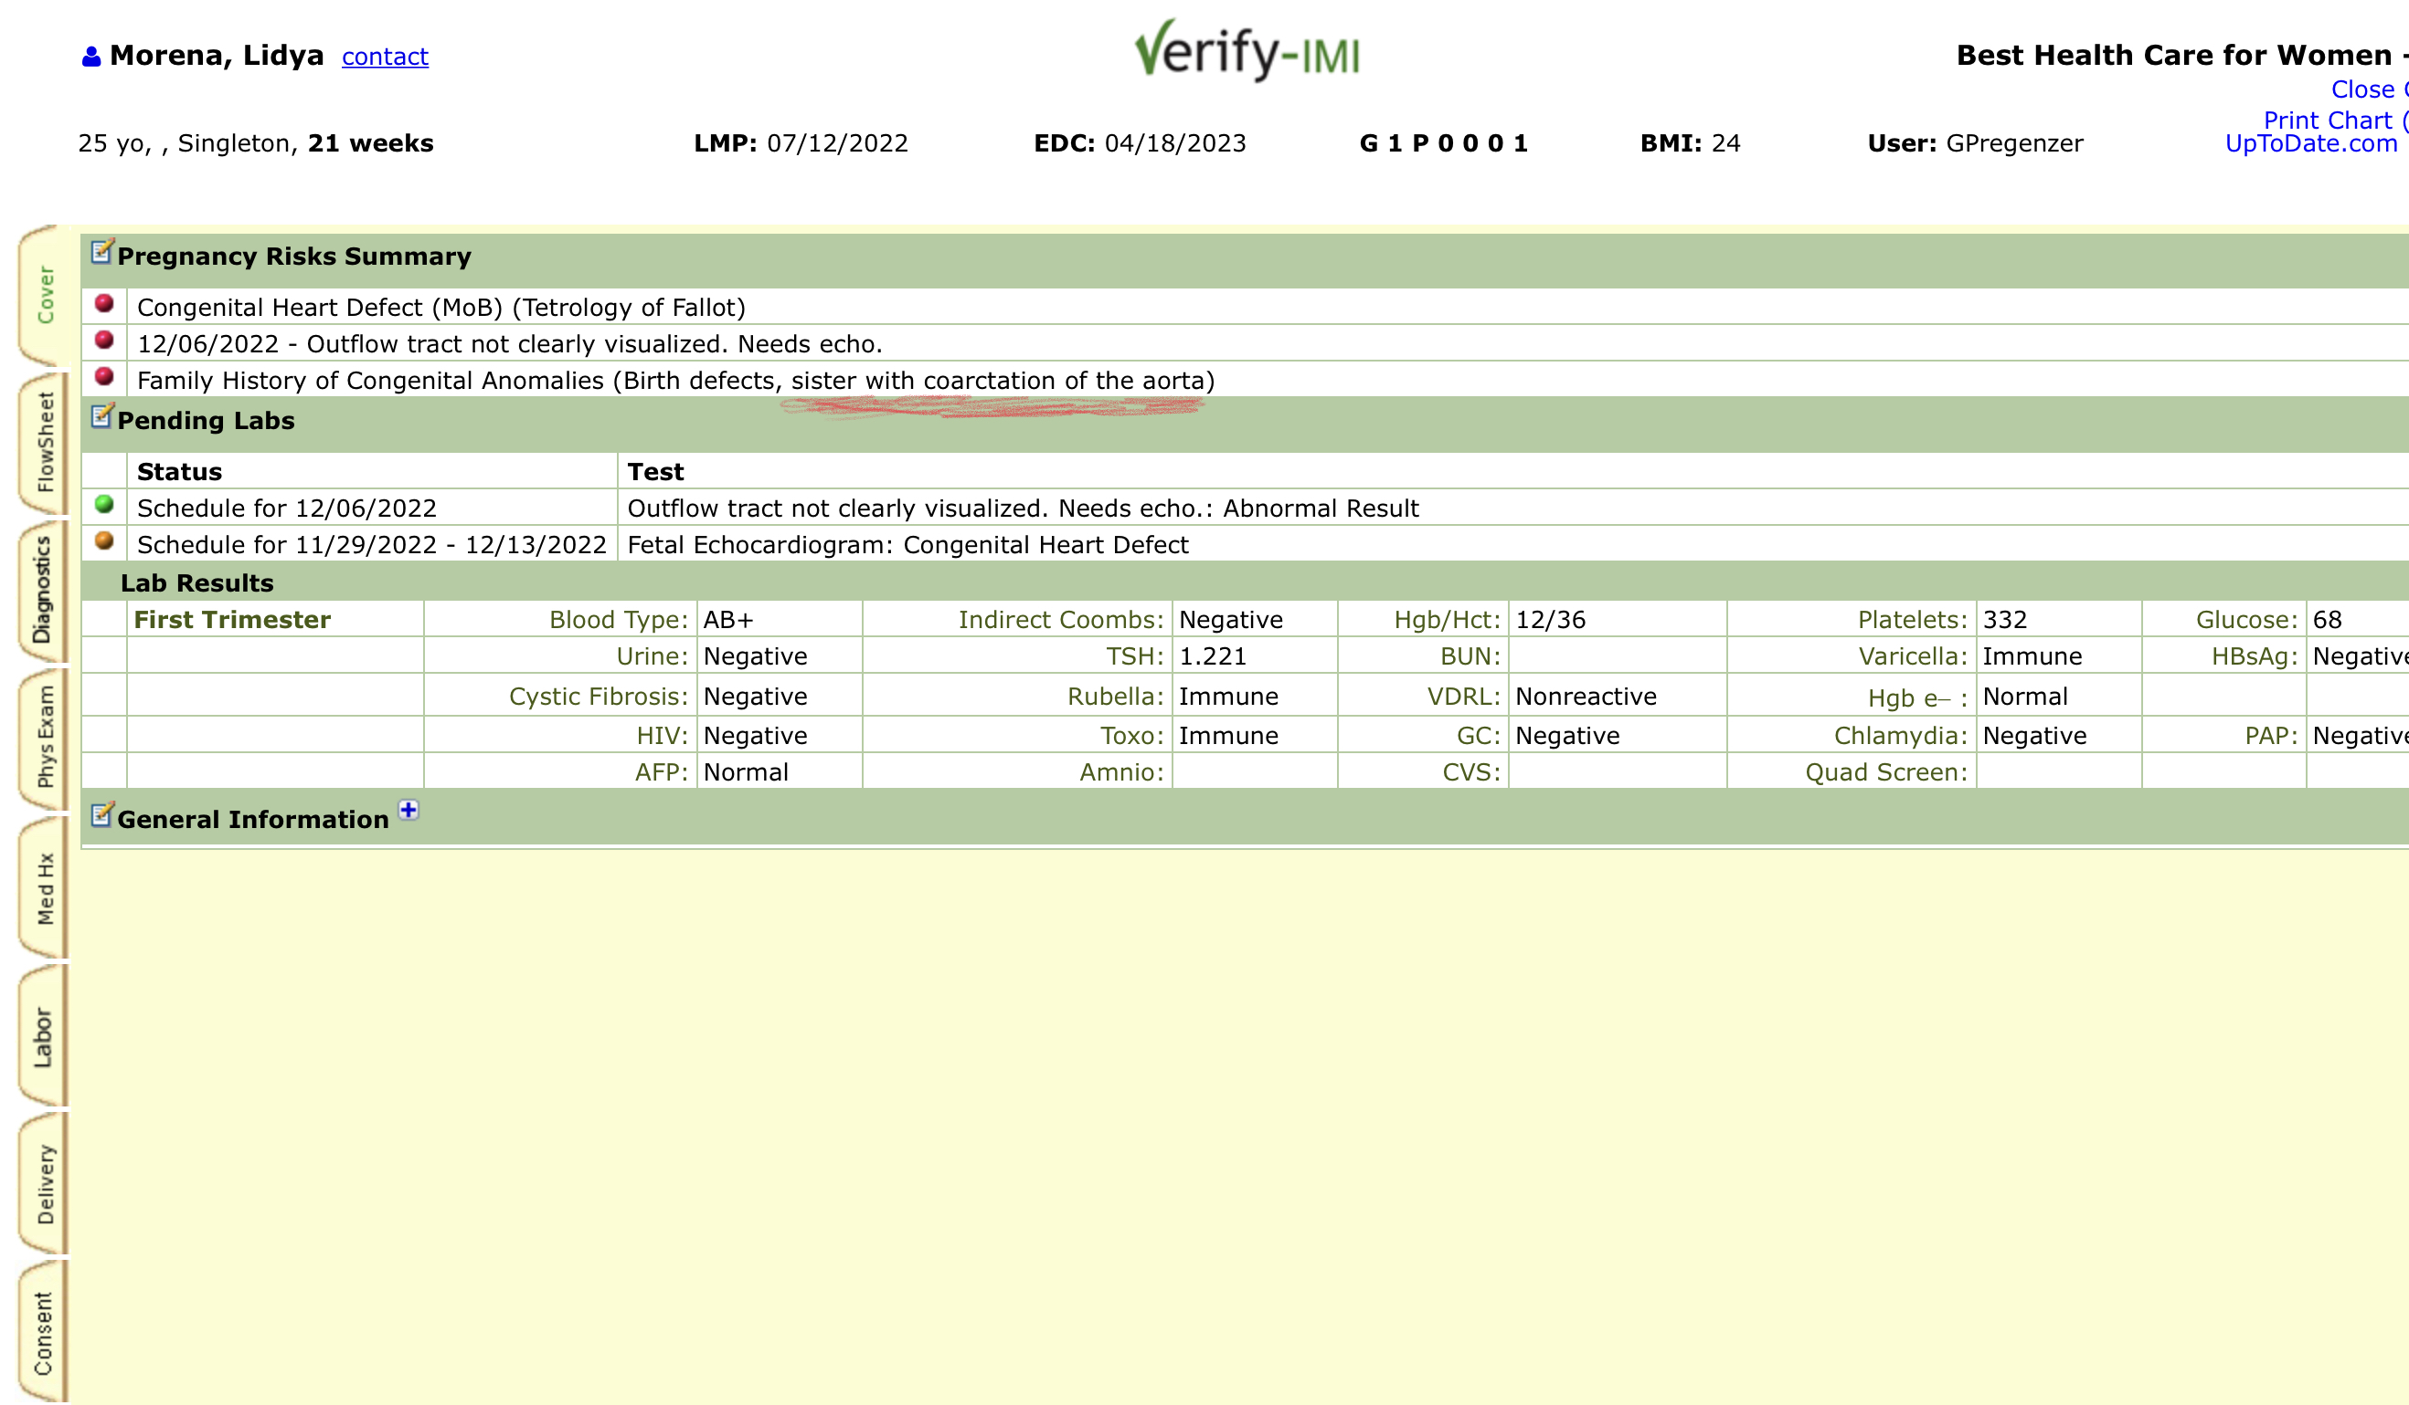

Slide 6
Antepartum Flowsheet

Slide 7
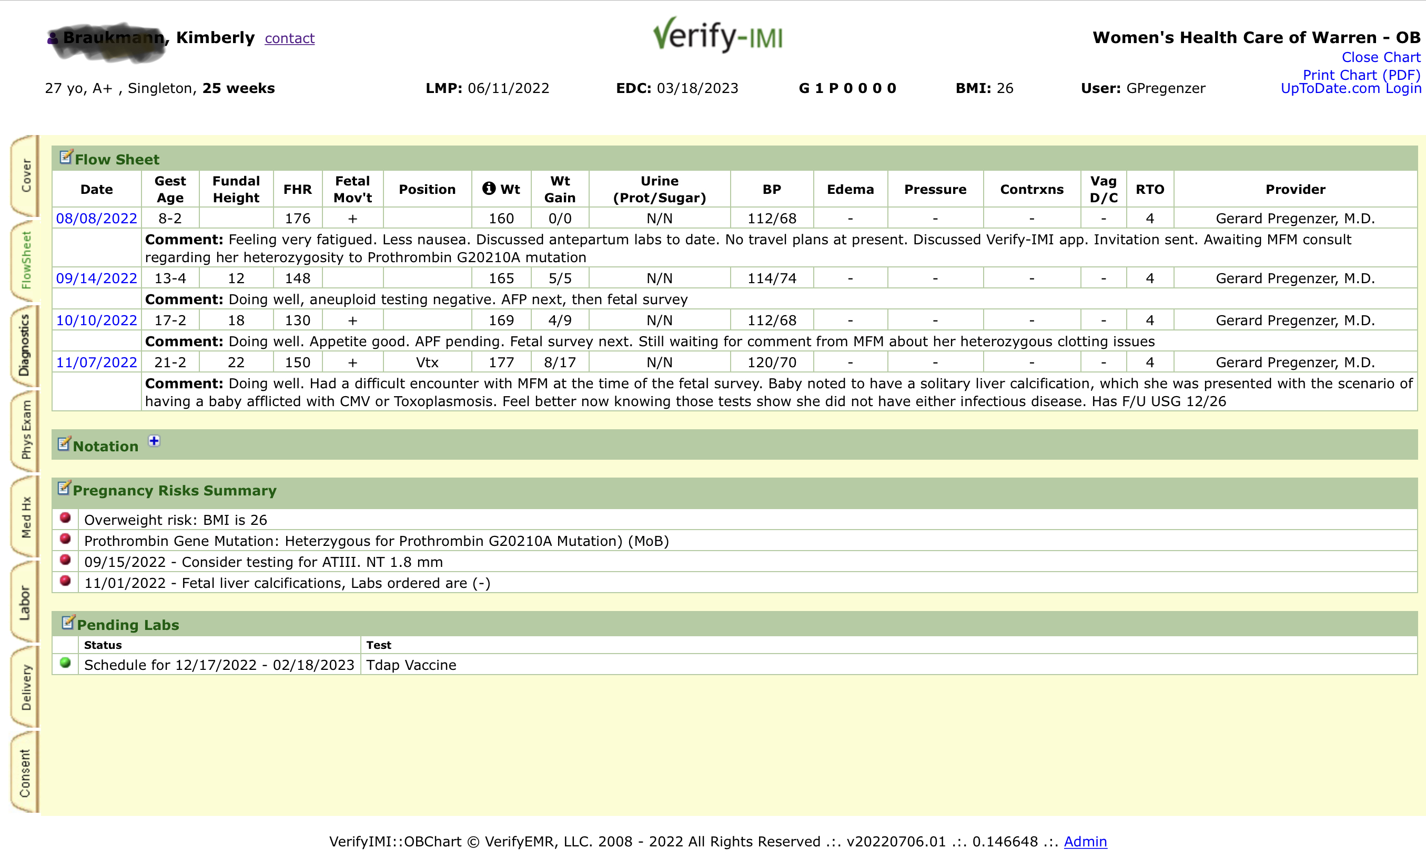

Slide 8
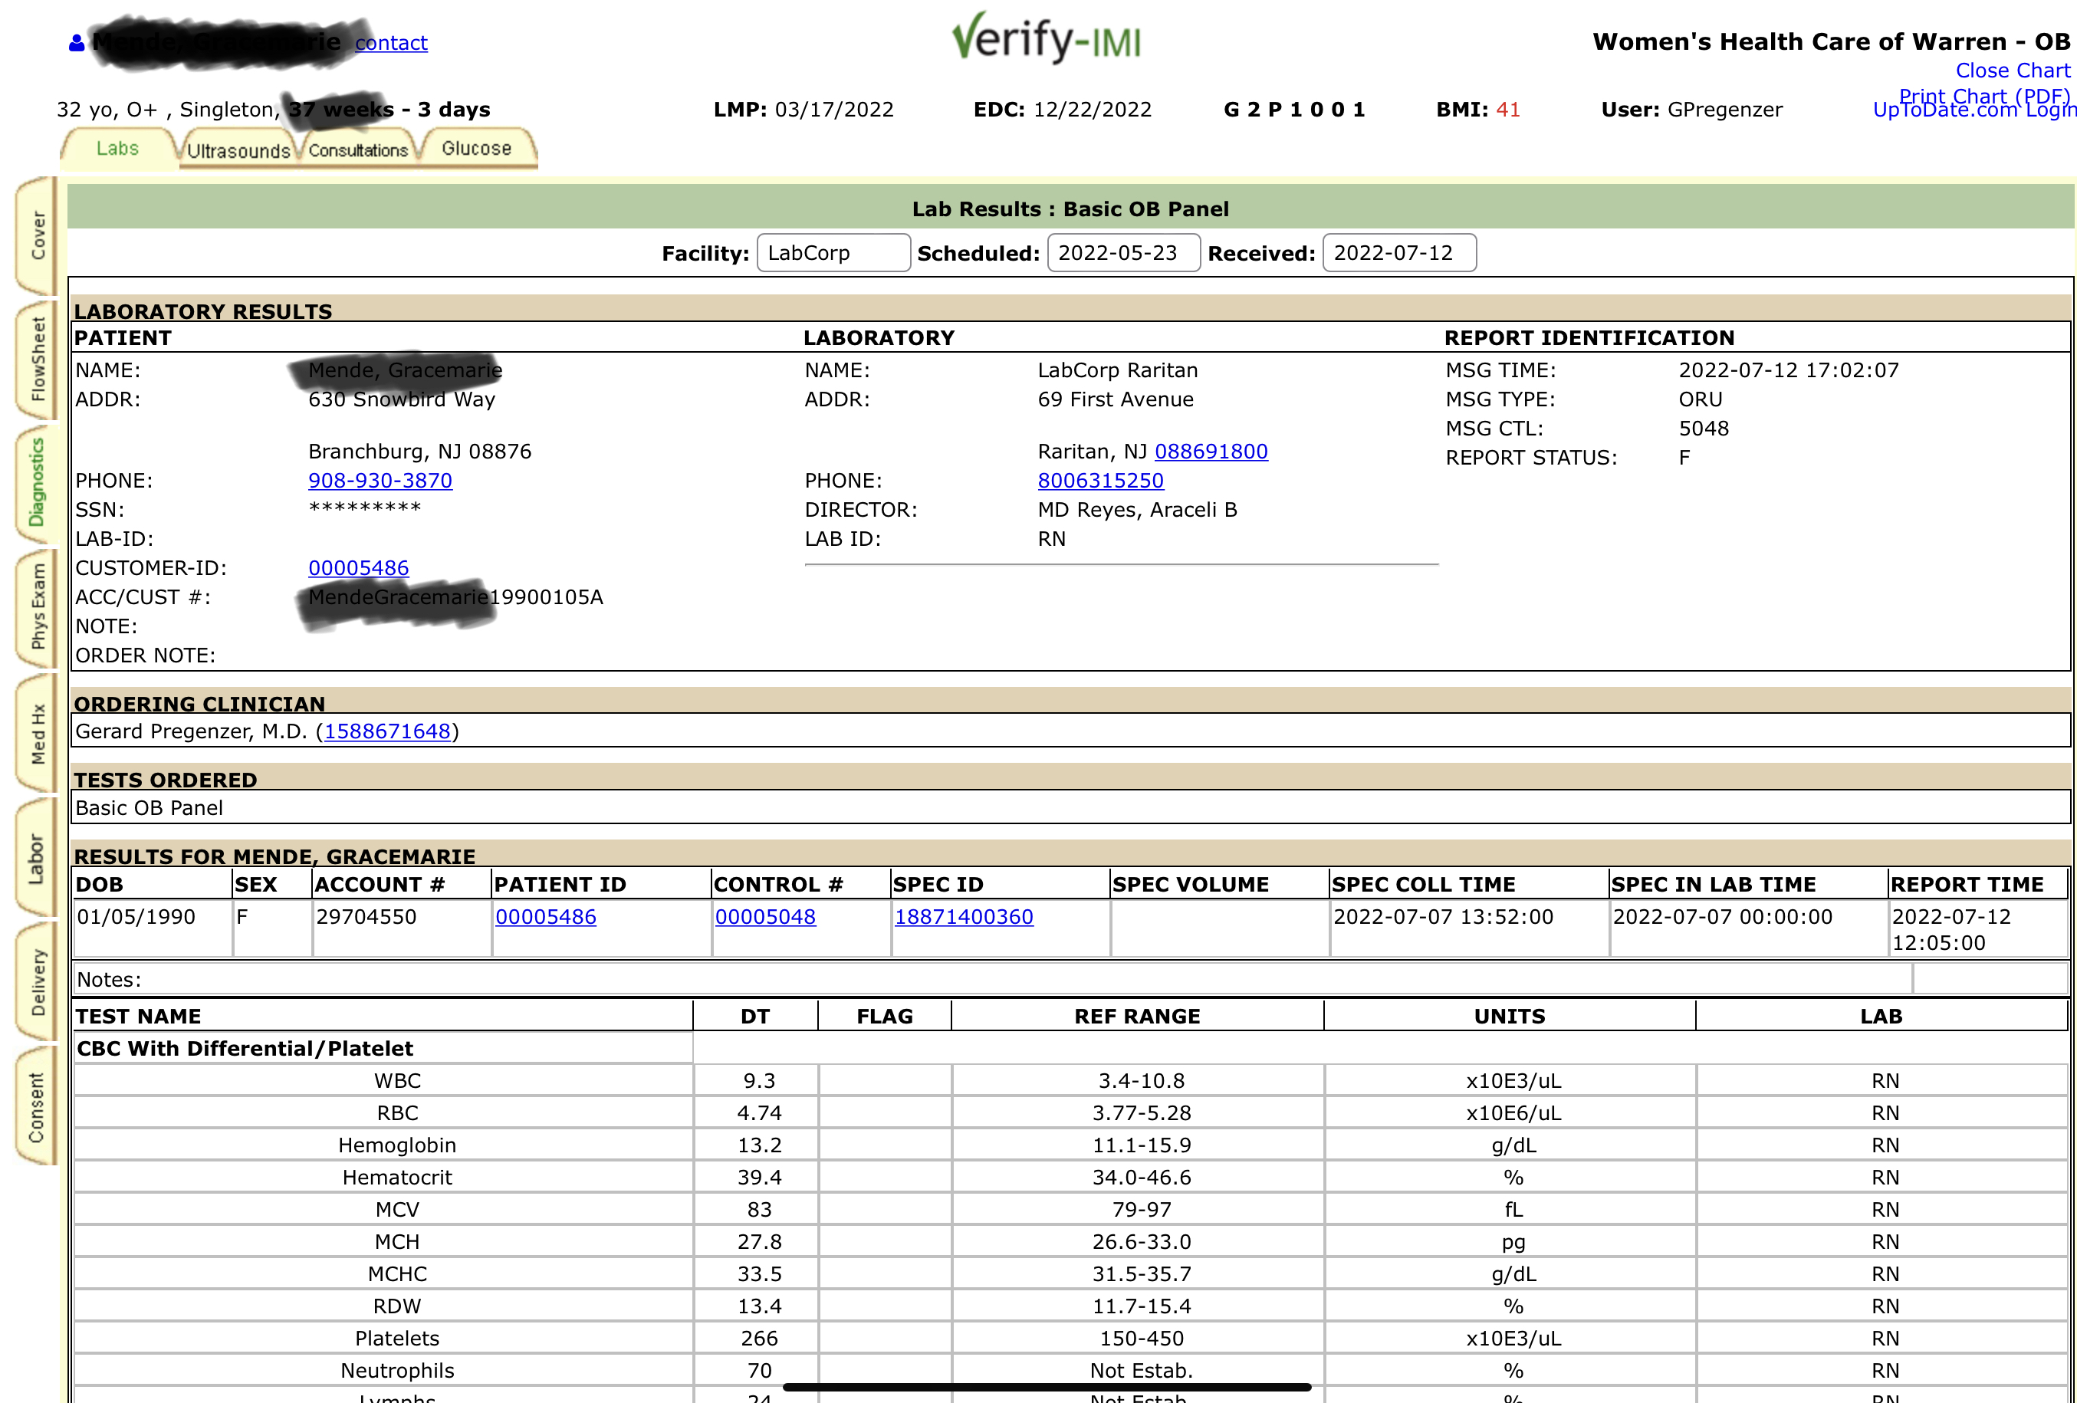

Slide 9
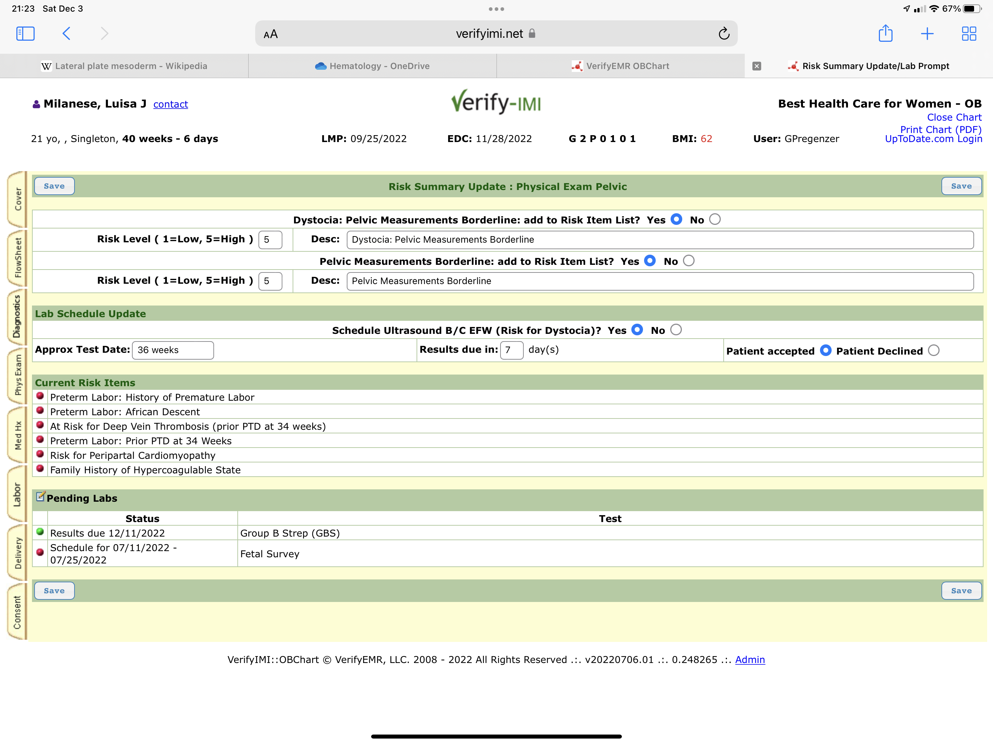

Slide 10
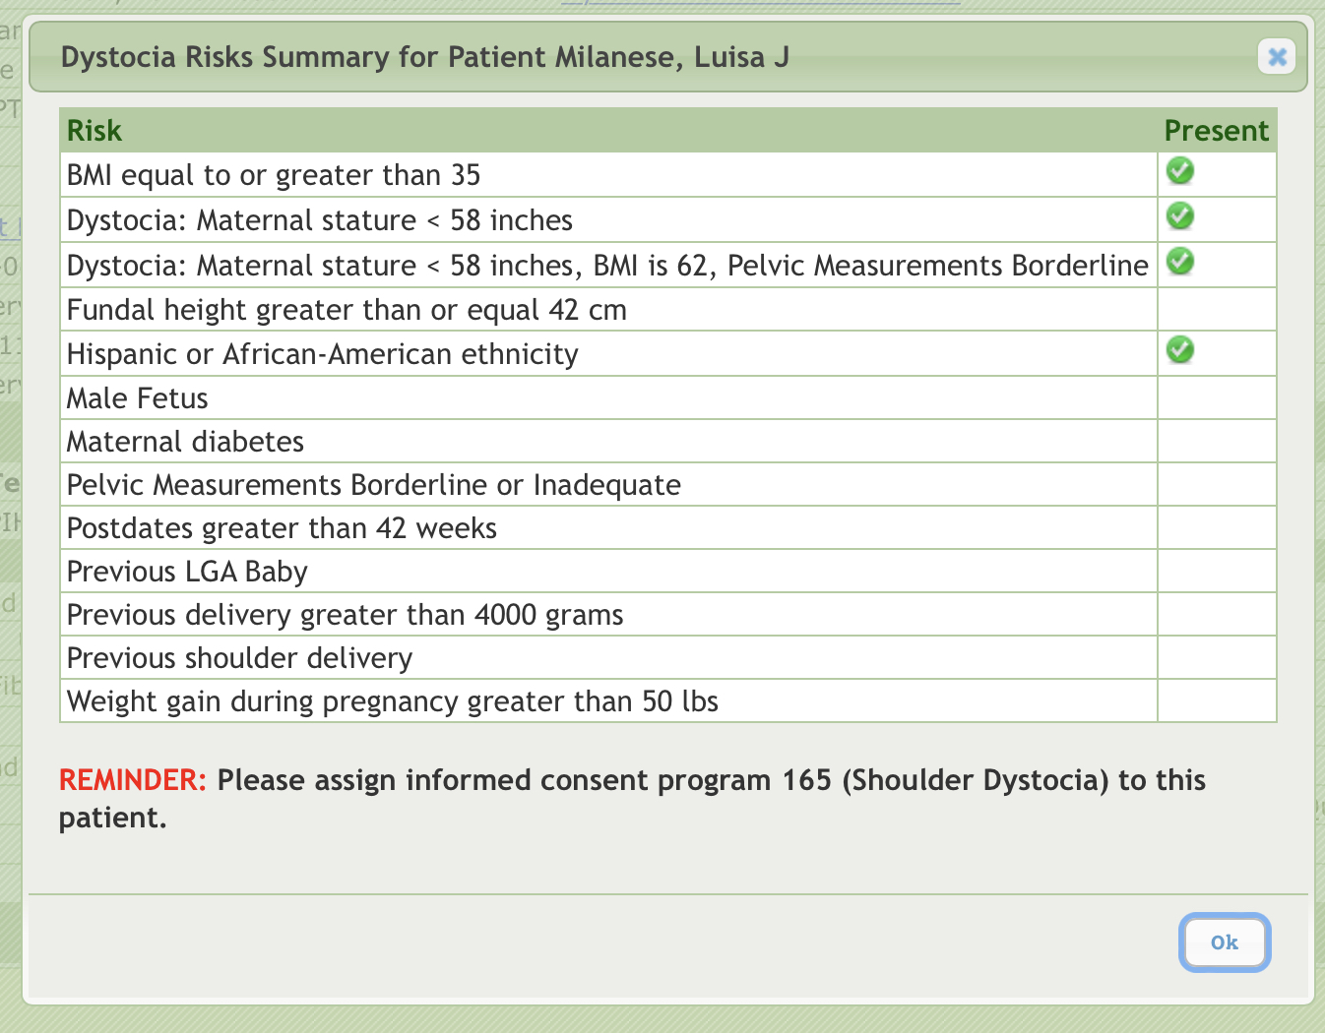

Slide 11
L & D

Slide 12
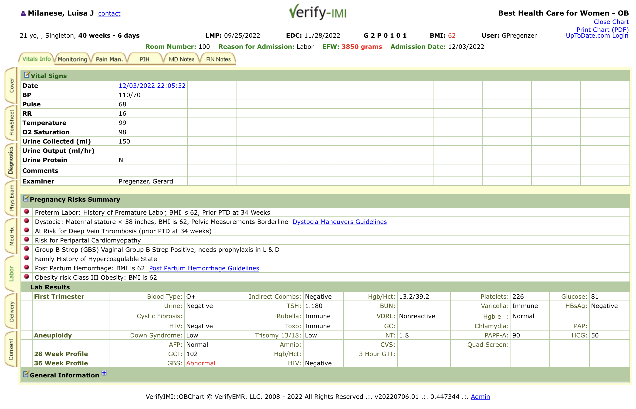

Slide 13
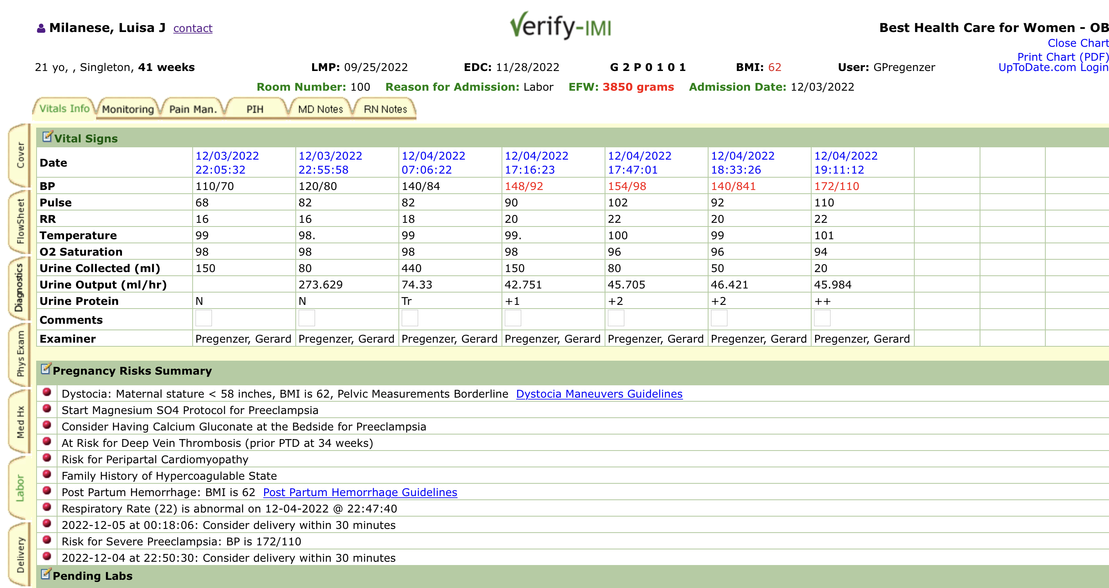

Slide 14
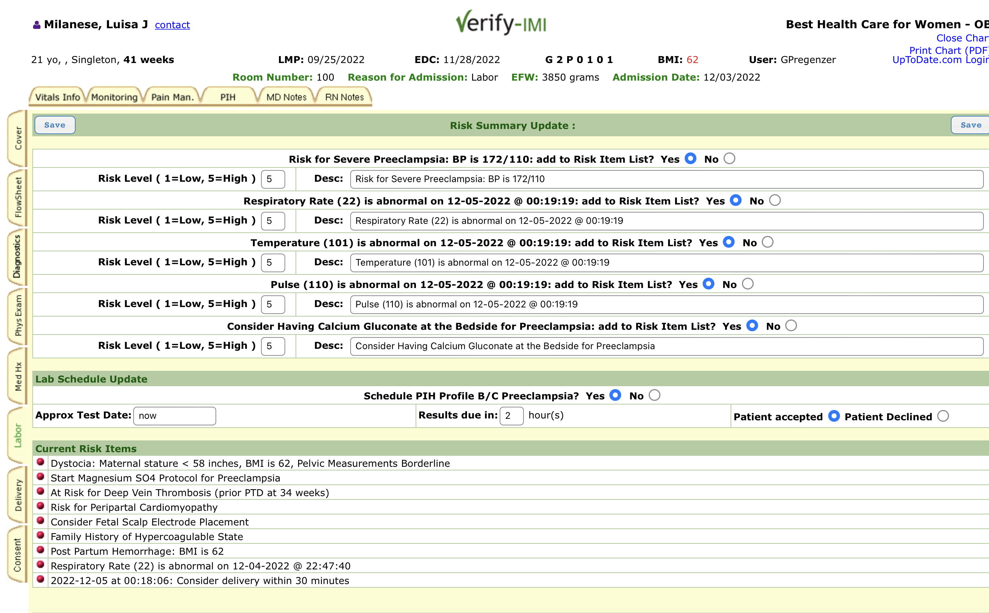

Slide 15
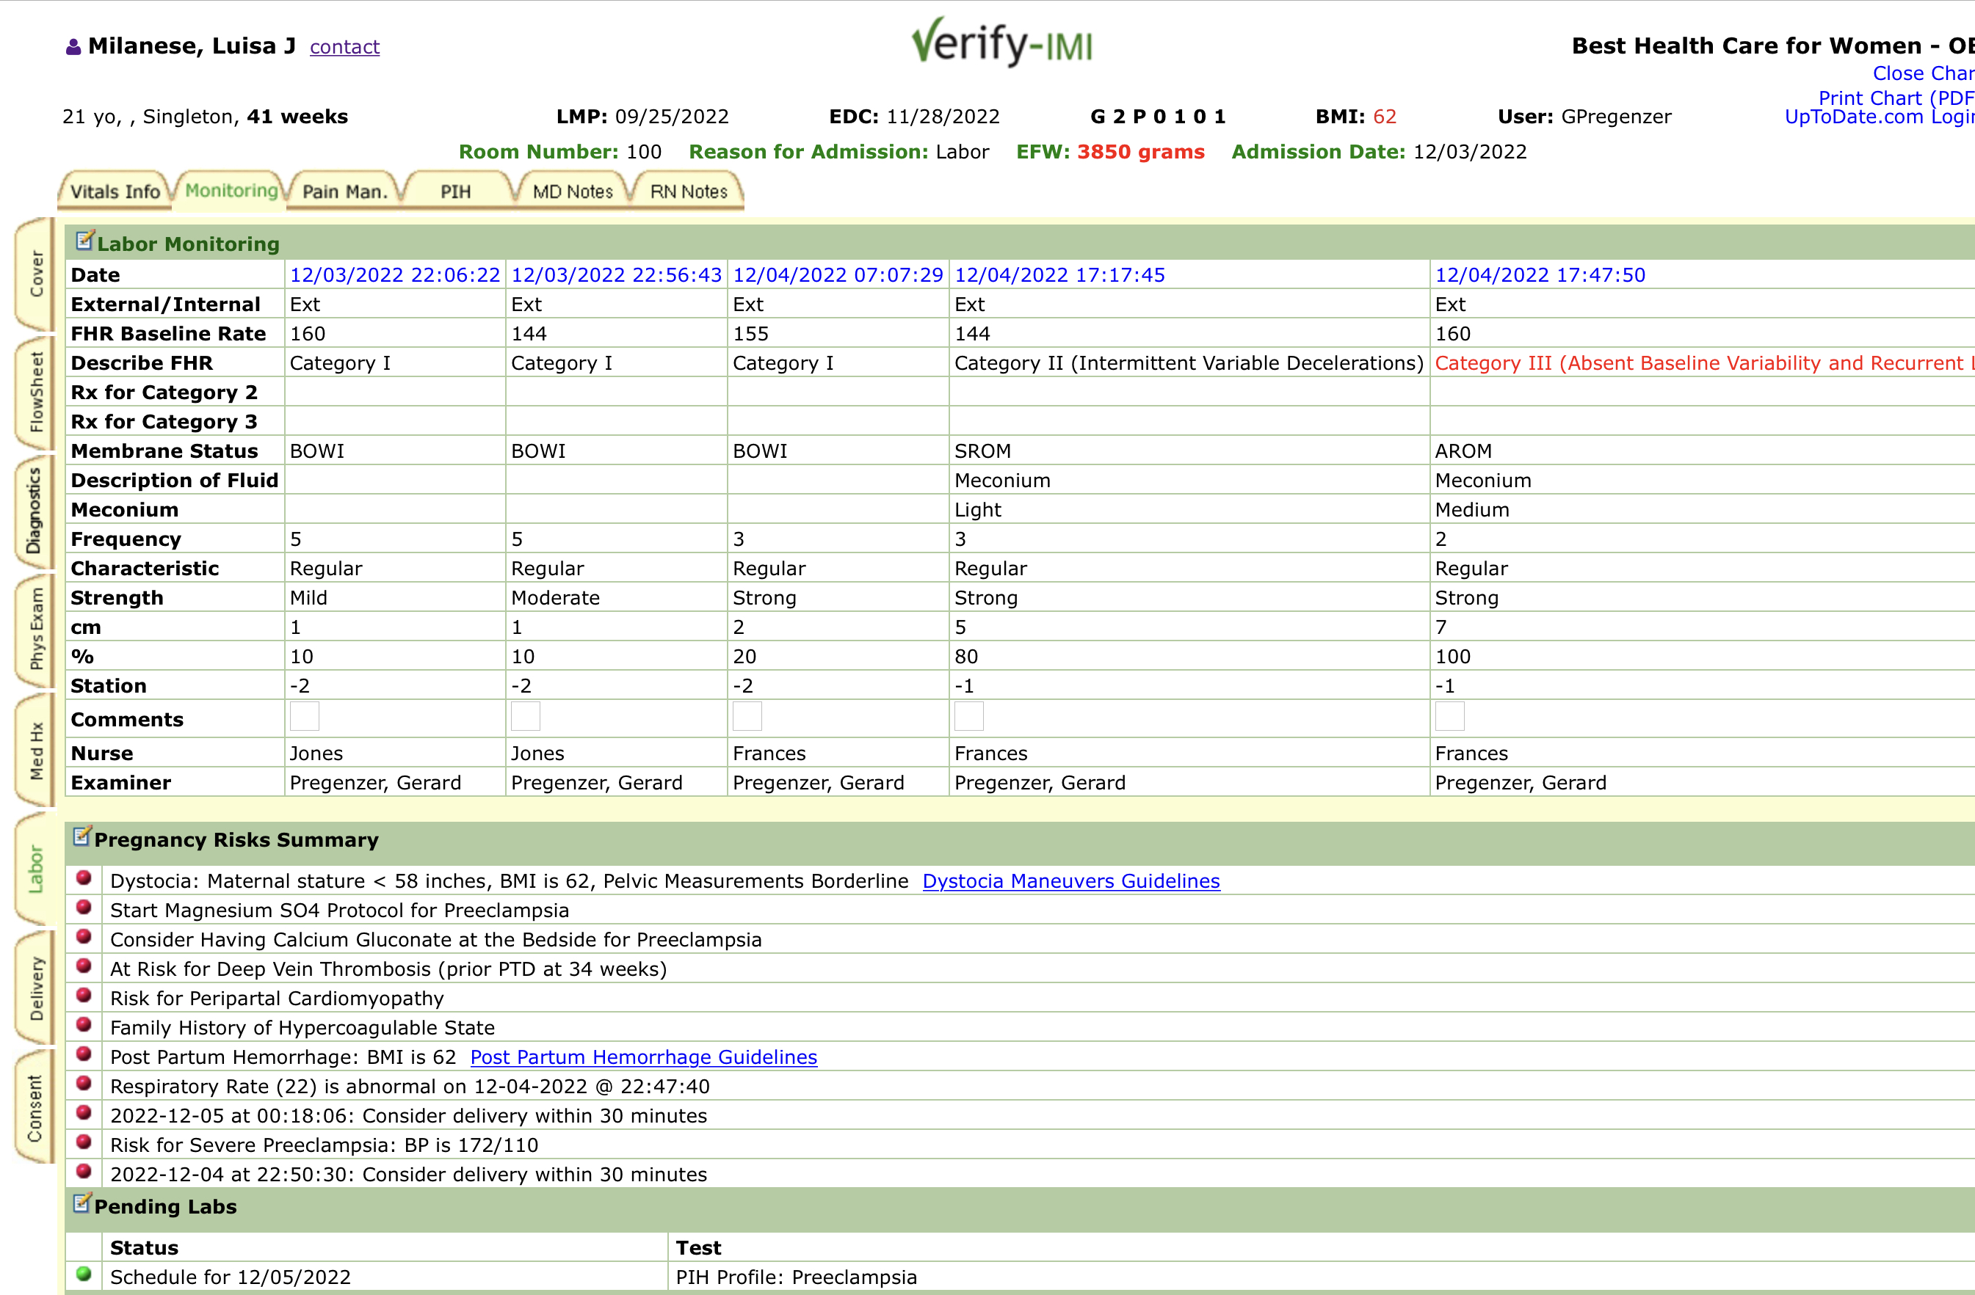

Slide 16
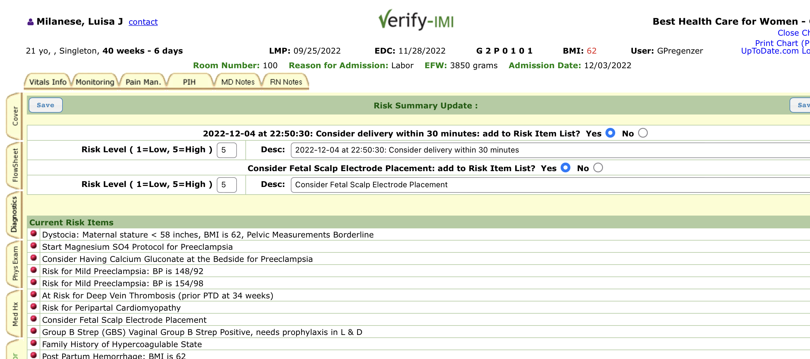

Slide 17
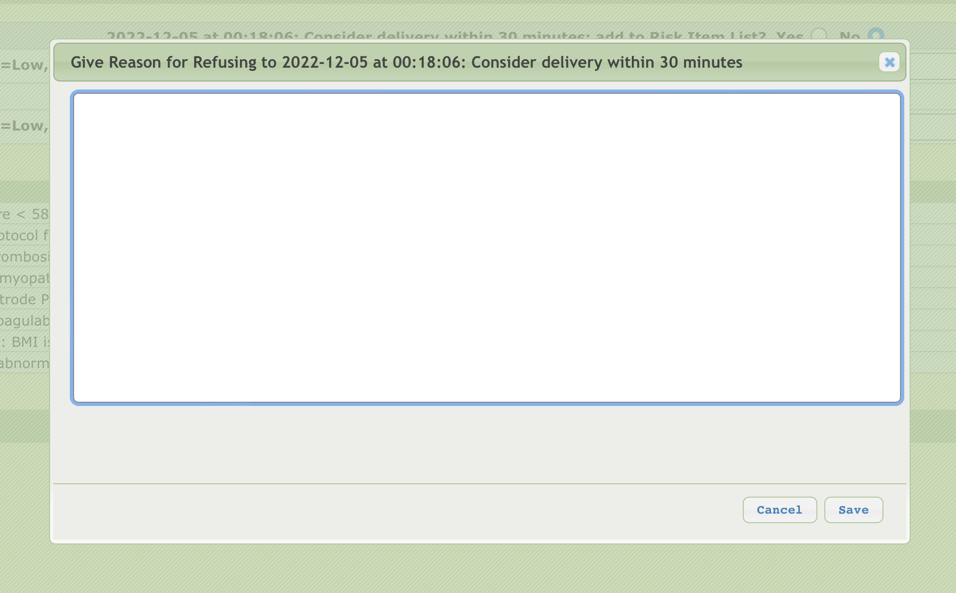

Slide 18
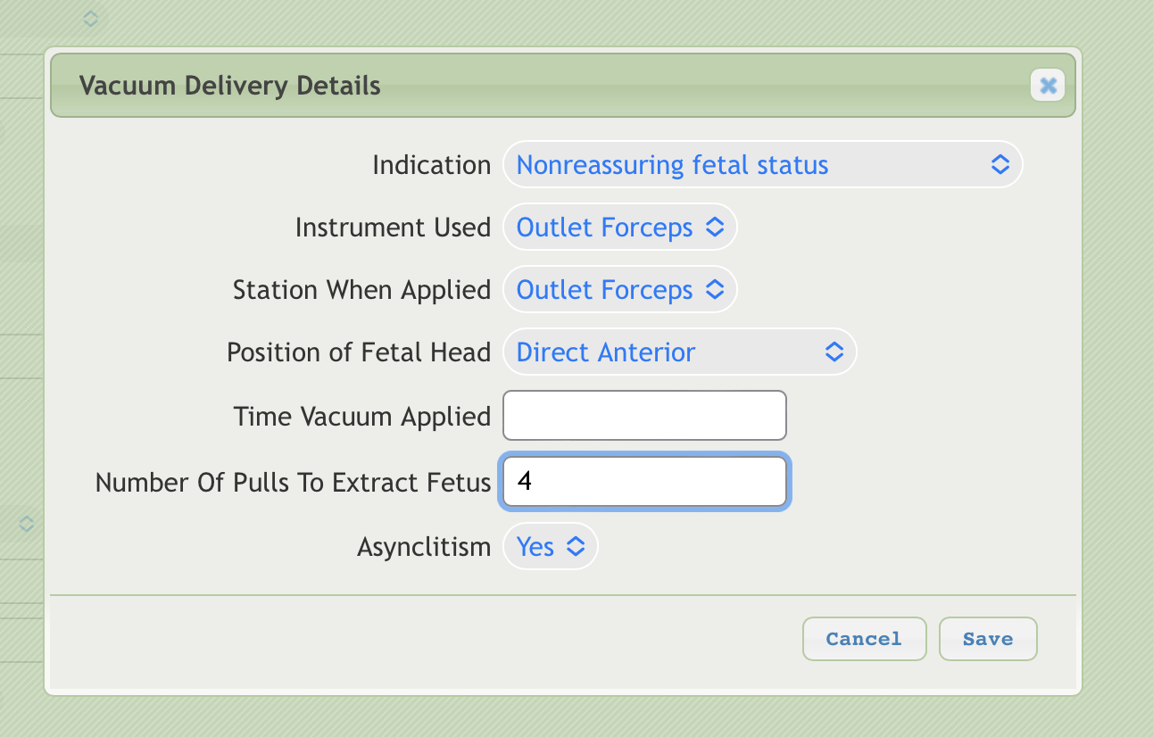

Slide 19
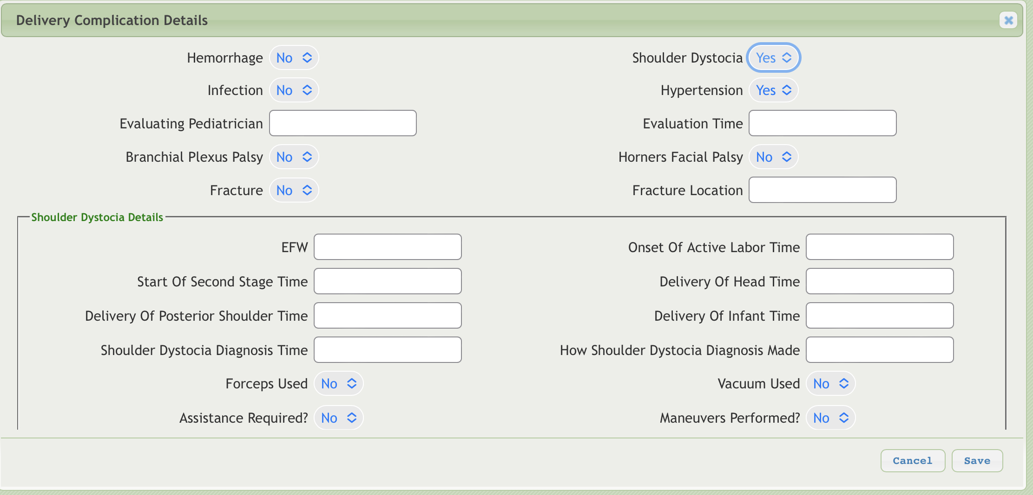

Slide 20
VerifyIMI Project
2601 patients entered into Verify
1760 antepartum through delivery
841 labor and delivery only

Slide 21
Results
Risks were identified in a timely fashion
Conveyance of clinical information more efficient/accurate
Positioning of risks
Higher Apgars
C/S 11.45 % vs 26%

Slide 22
Conclusion
Humans make mistakes
39% of records analyzed have errors
EMRs track billing, inventories and post information
Should use the power of the computer to analyze
Time for Interactive Medical Intelligence
Medicine can do better

